Slide 1
UCF Data analytics and visualization bootcamp Project 1 Group 3 - Jomesco Analysis of Total 2016 Florida Tax Returns
John Plakon
Melissa Roman
Scott Brown

Slide 2
Introduction
Income bracket breakdowns
Retirement data
General tax information
Statistical analysis

Slide 3
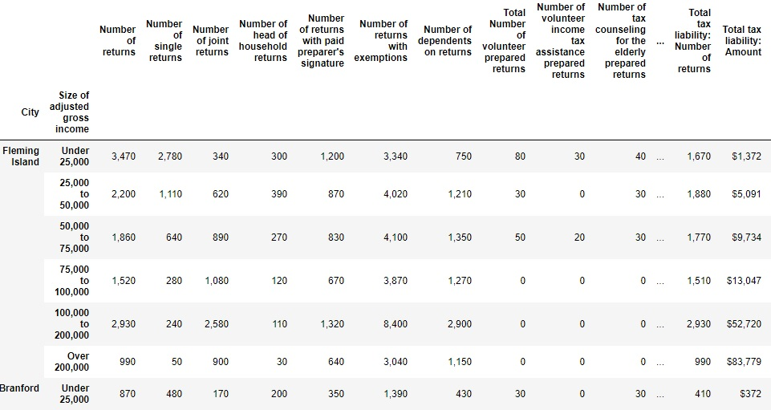
Data Indexed by City and Income Bracket

Slide 4
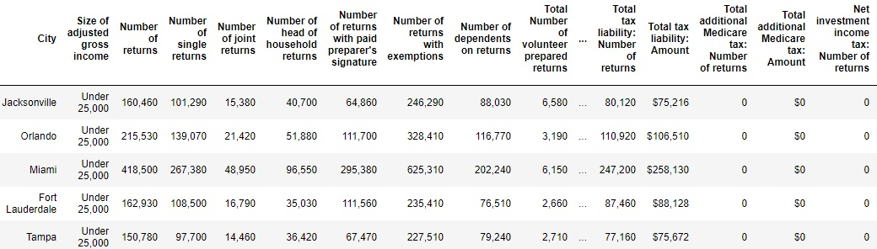
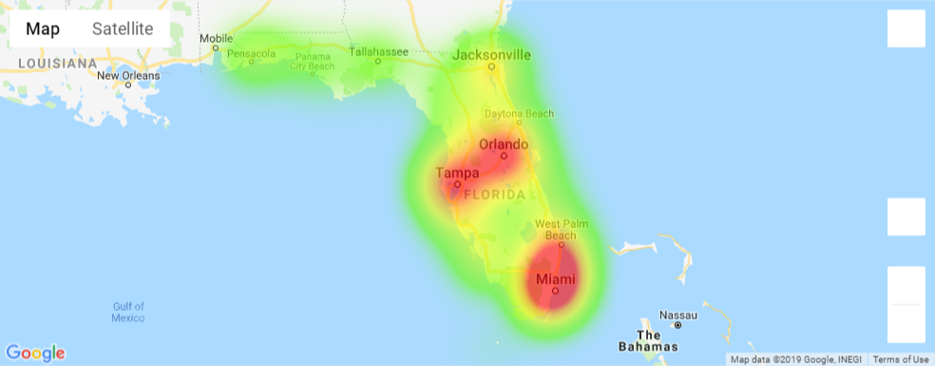
Top 5 Lower Income Brackets for Number of Returns

Slide 5
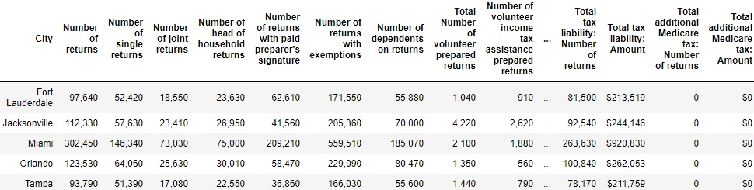
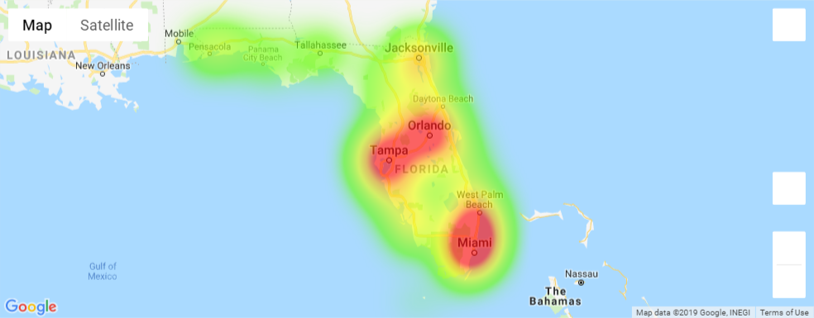
Top 5 Middle Income Brackets for Number of Returns

Slide 6
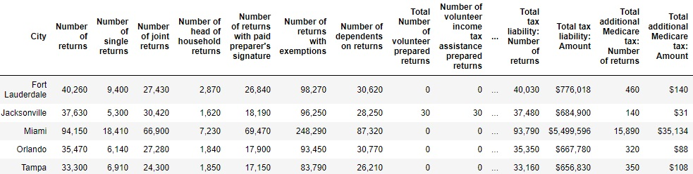
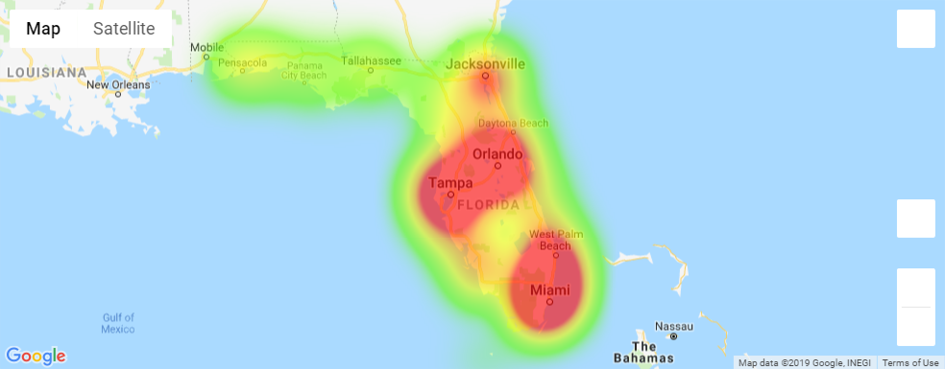
Top 5 Upper Income Brackets for Number of Returns

Slide 7
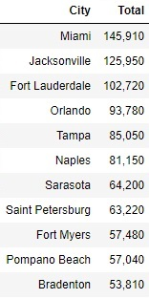
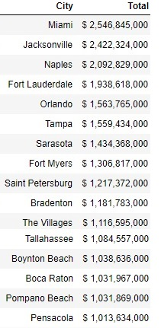
Cities With 50,000+ Retirement Returns
Cities WIth1 Billion+ Retirement Income

Slide 8
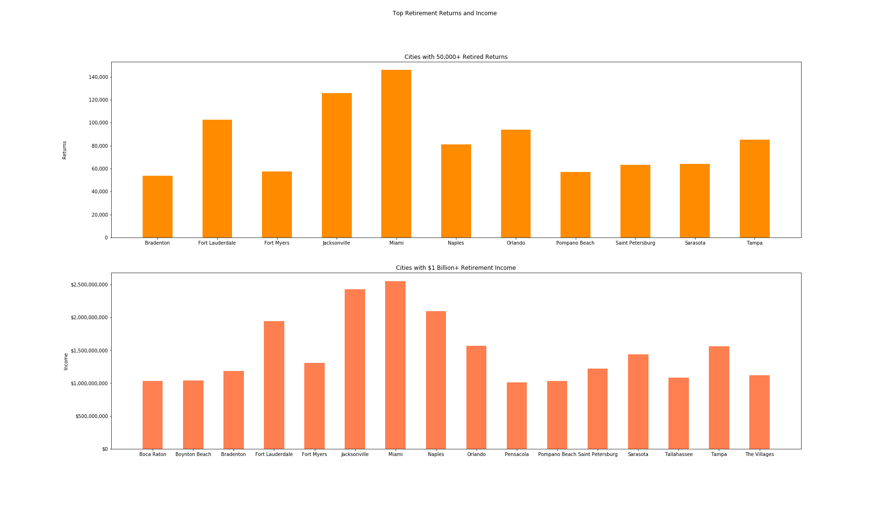

Slide 9
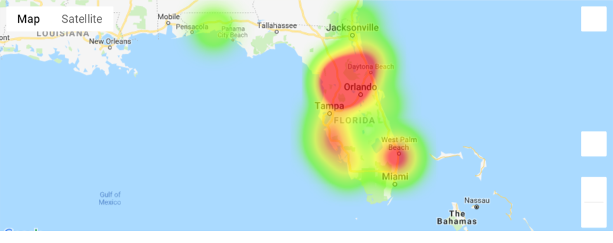
Retirement Returns by Zip Code Heat Map

Slide 10
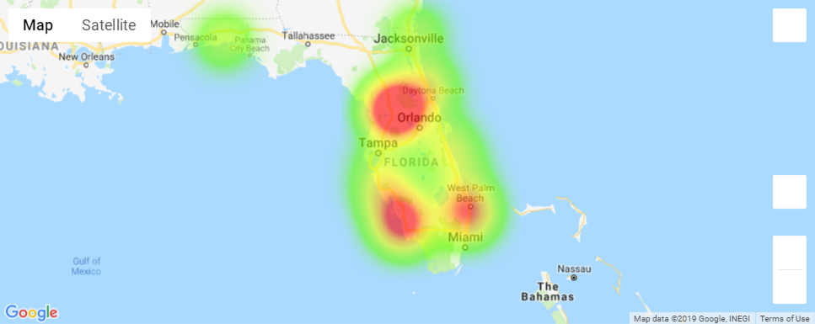
Retirement Income by Zip Code Heat Map

Slide 11
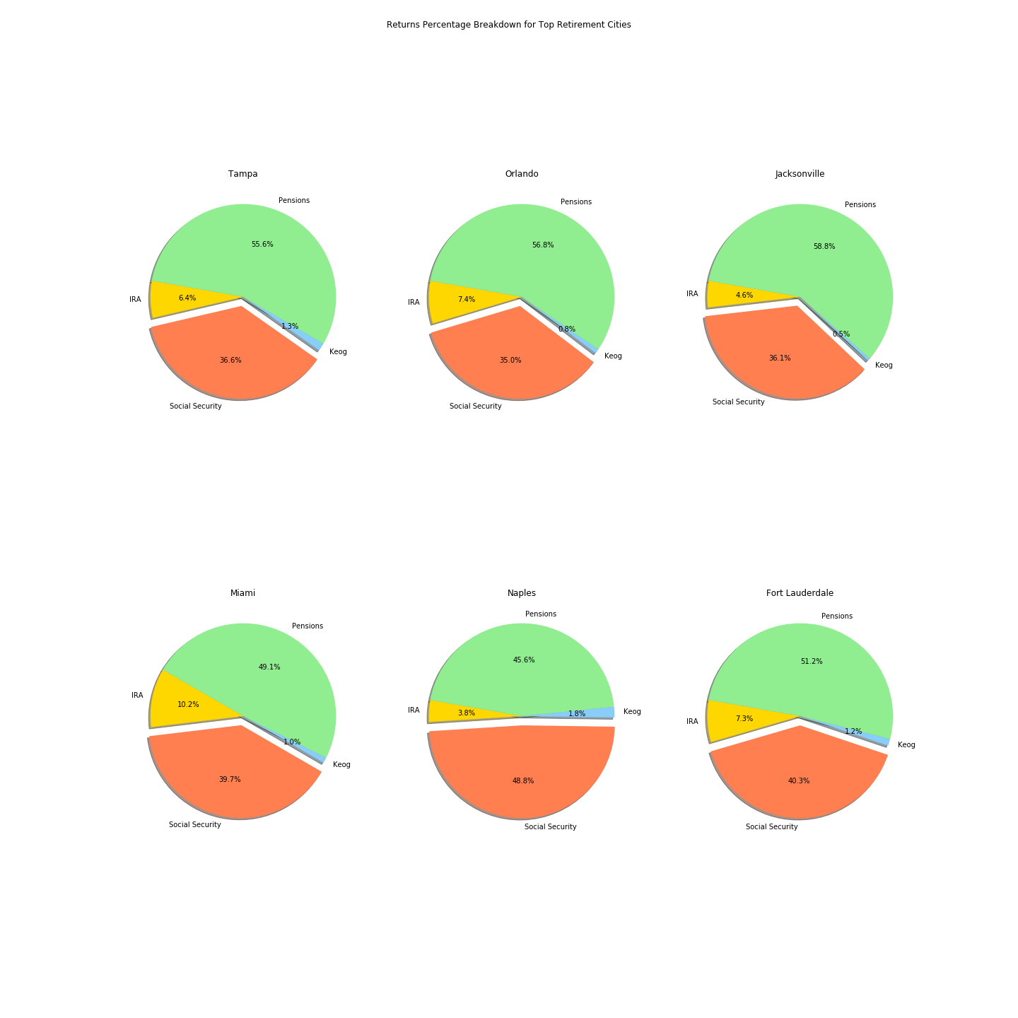
Retirement Breakdown Top 6 Cities

Slide 12
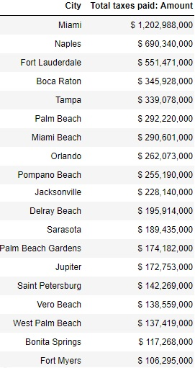
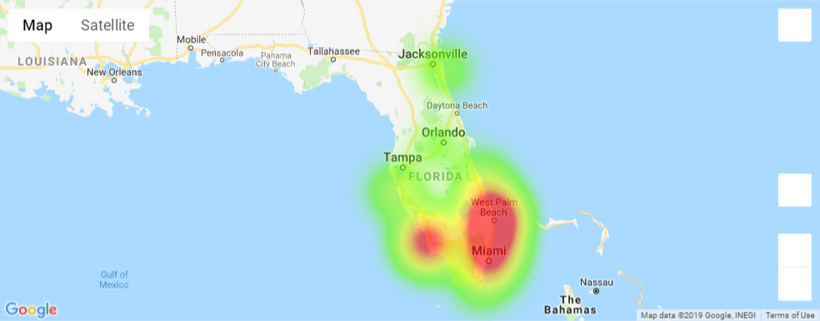
Top Tax Paying Cities

Slide 13
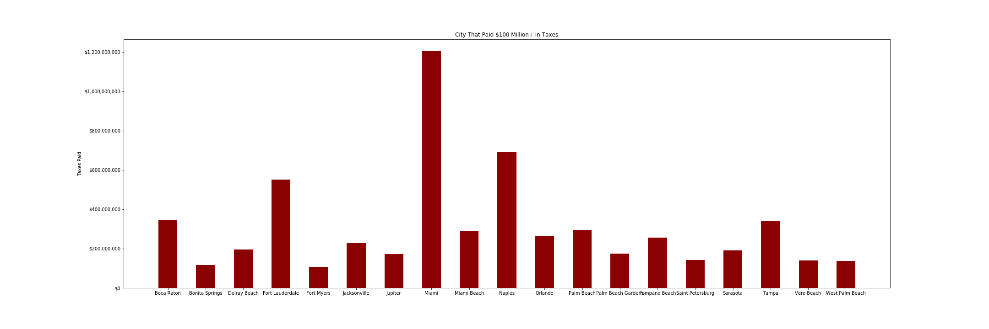
Top Tax Paying Cities

Slide 14
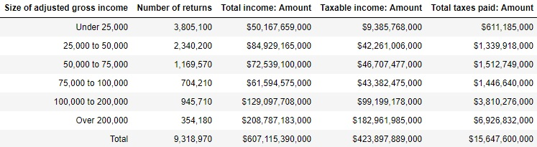
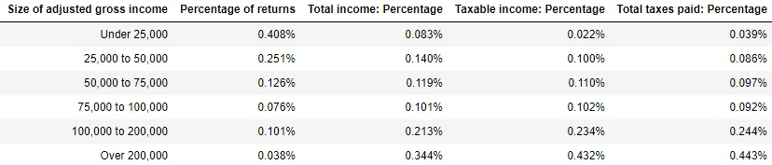
Tax Bracket Breakdown
Tax Bracket Breakdown Percentage

Slide 15
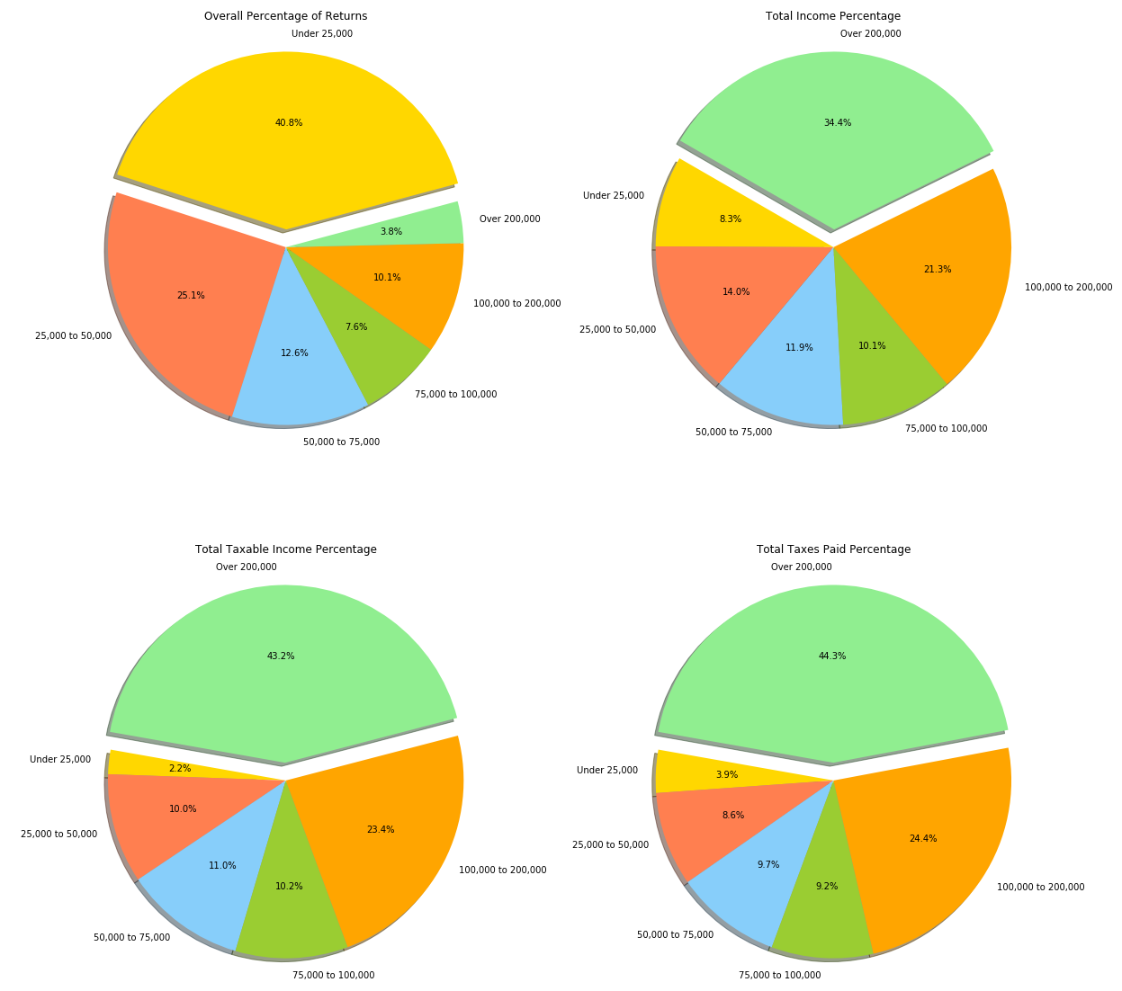
Who Is Paying the Taxes?

Slide 16
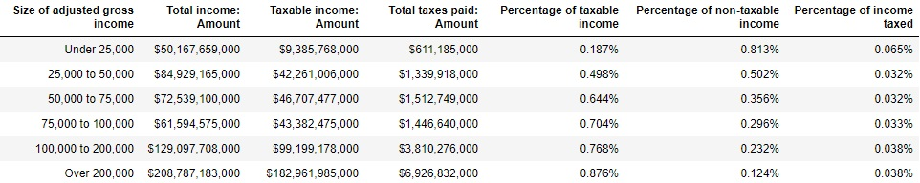
Tax vs Non-Taxable Breakdown by Income Bracket

Slide 17
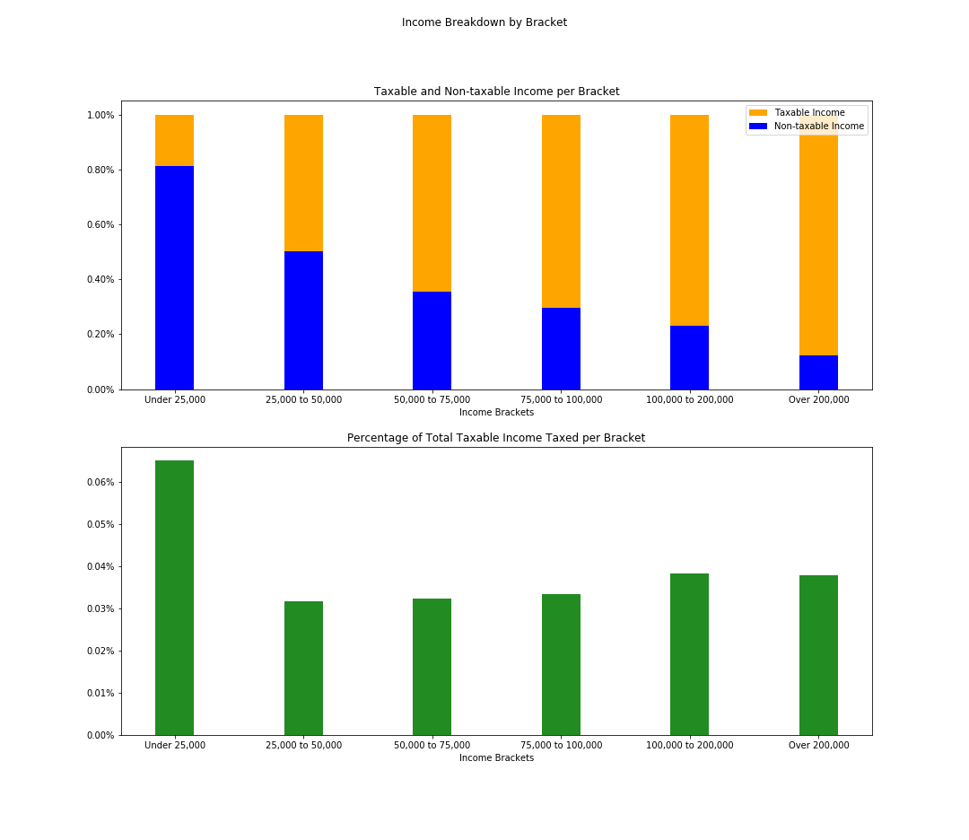
Taxable and Non-Taxable Income Per Bracket
Percentage of Total Taxable Income Per Tax Bracket

Slide 18



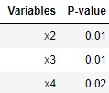


Which Variables are Significant for Income in the $200,000+ Bracket? - Stepwise Regression Models
Use Stepwise Regression to find models with only significant variables for:
Total Income, Taxable Income, Total Taxes Paid
Forward: Add variables, only keep significant variables in model, repeat
Backward: Start model with all variables, drop insignificant variables, repeat

Slide 19
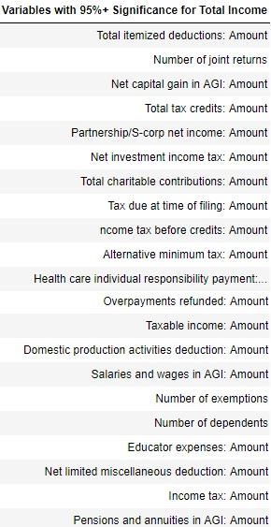
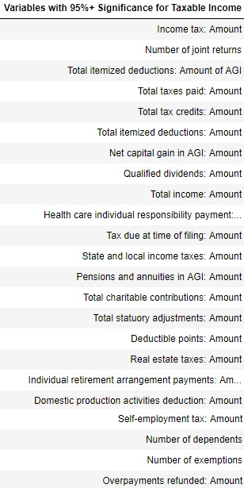
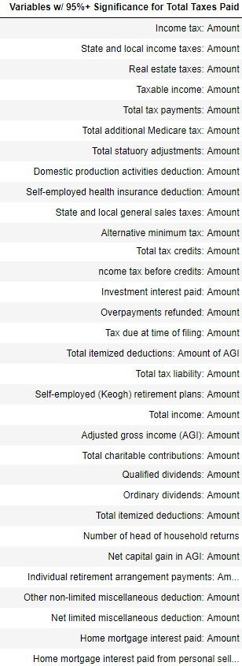
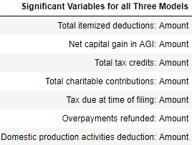
Significant Variables for Stepwise Regression Models

Slide 20
Conclusions
The top income bracket is the most taxed, but they bring in the most taxable income.
The top income bracket takes in the least amount of non-taxable income.
The bottom income bracket takes in the most non-taxable income.
The percentage of taxable income vs taxes paid is surprisingly low
Central and Northern Florida retirees rely more on social security than their southern counterparts.
Being the most populated city, Miami affects a lot of the data.
Highest income city.
Highest tax paying city.
Surprisingly, it has the most retirees.
The top 5 cities, for number of returns, for the 3 income brackets (lower, middle, and upper) are the same.
Miami, Orlando, Tampa, Jacksonville, and Fort Lauderdale.

